Slide 1
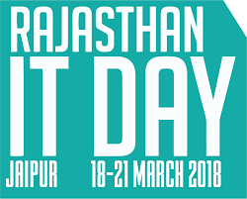
RAJASTHAN IT DAY 2018
HACKATHON 4.0

Slide 2
KRISHI VIKAS

Slide 3
Problem Statement
IDEA
Improve crop quality
Introduce new and effective farming techniques
Maximum agriculture services.
Problems solved :
1. Awareness to new technologies used in farming.
2. Effective way to develop a crop and solve farming related issues.
3. Provide value for money.
4. Easy solutions to farmer regarding cultivation of crops.
5. Early predictions of cultivated crops .
6. Early prediction of market value of their crops .
7.Controls farming frauds .
8. Everything at one place.

Slide 4
Solution
We will be providing a easy accessible application for the farmers, that can easily run on their smart phones. This app will solve the problem of awareness in farming techniques. This will help farmers to do sustainable and effect farming using recommended ways form agriculture experts and many more agricultural reviews on internet. They will get the ideas about the new technologies used in farming and then they can update their techniques and make more output in less input. This app will also control the fraud with the farmers. As the application can show them the market price of their product and they can get the maximum amount for there crop.

Slide 5
Concept
An easily accessible application for the farmers that can easily run on their smart phones.
Sustainable , smart and effective farming .
Quick access to important content across the web (Recommendation System) .
Market analysis that suggests which crop should be grown. (Data Mining )

Slide 6
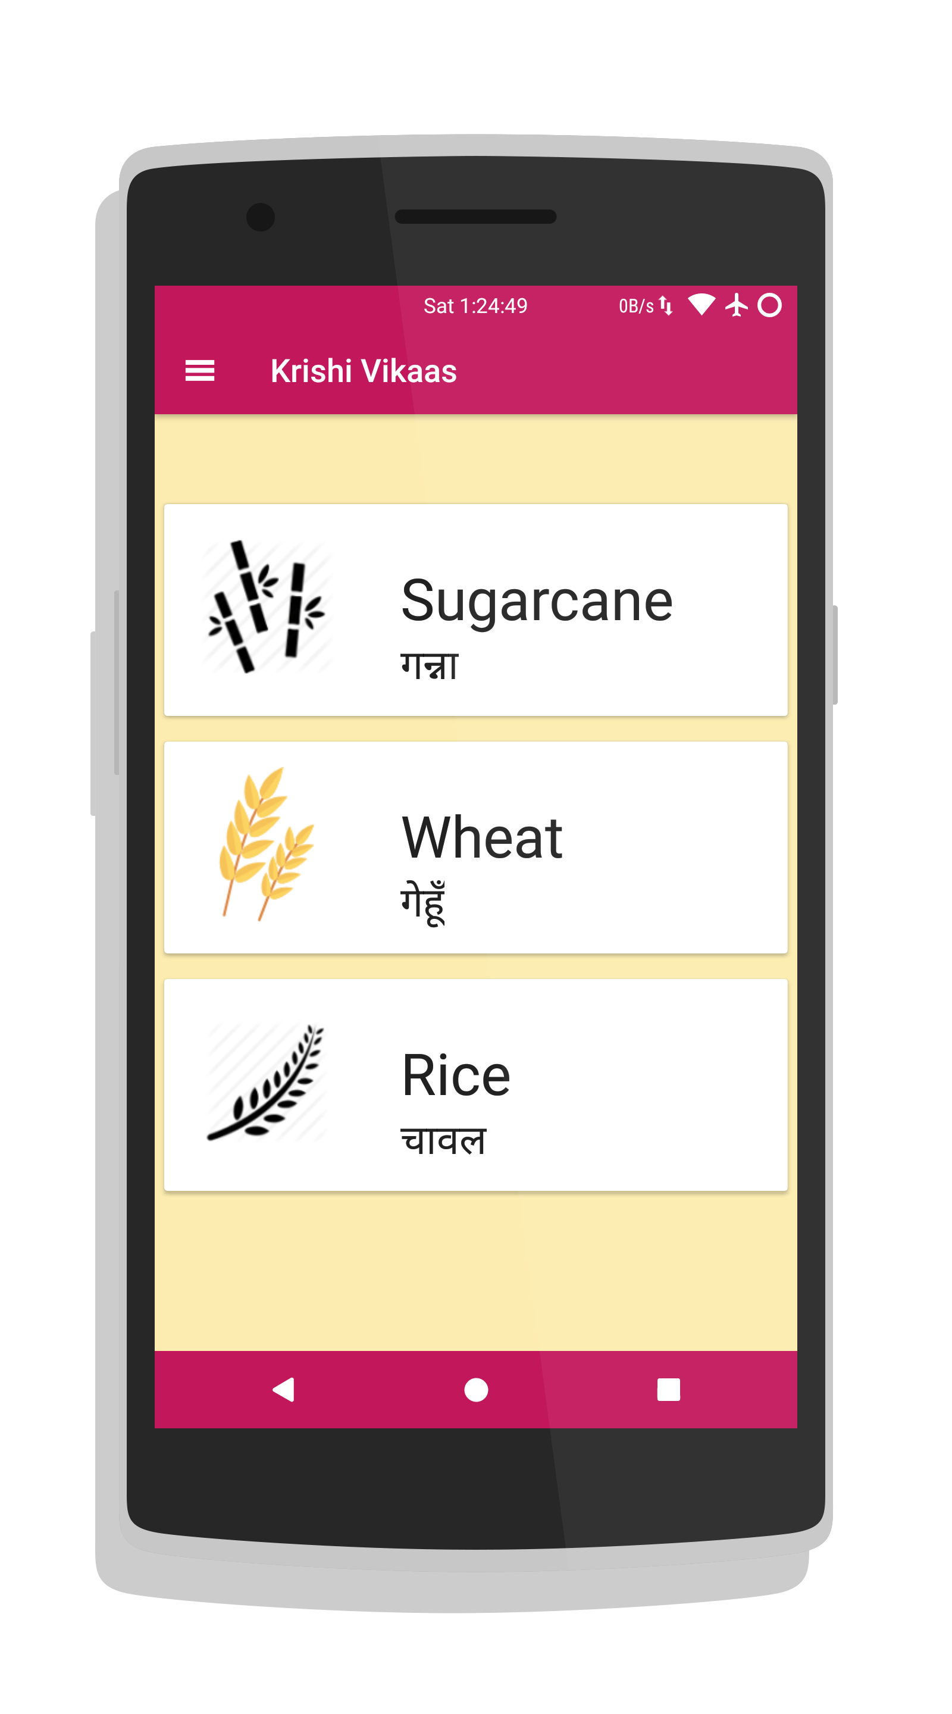
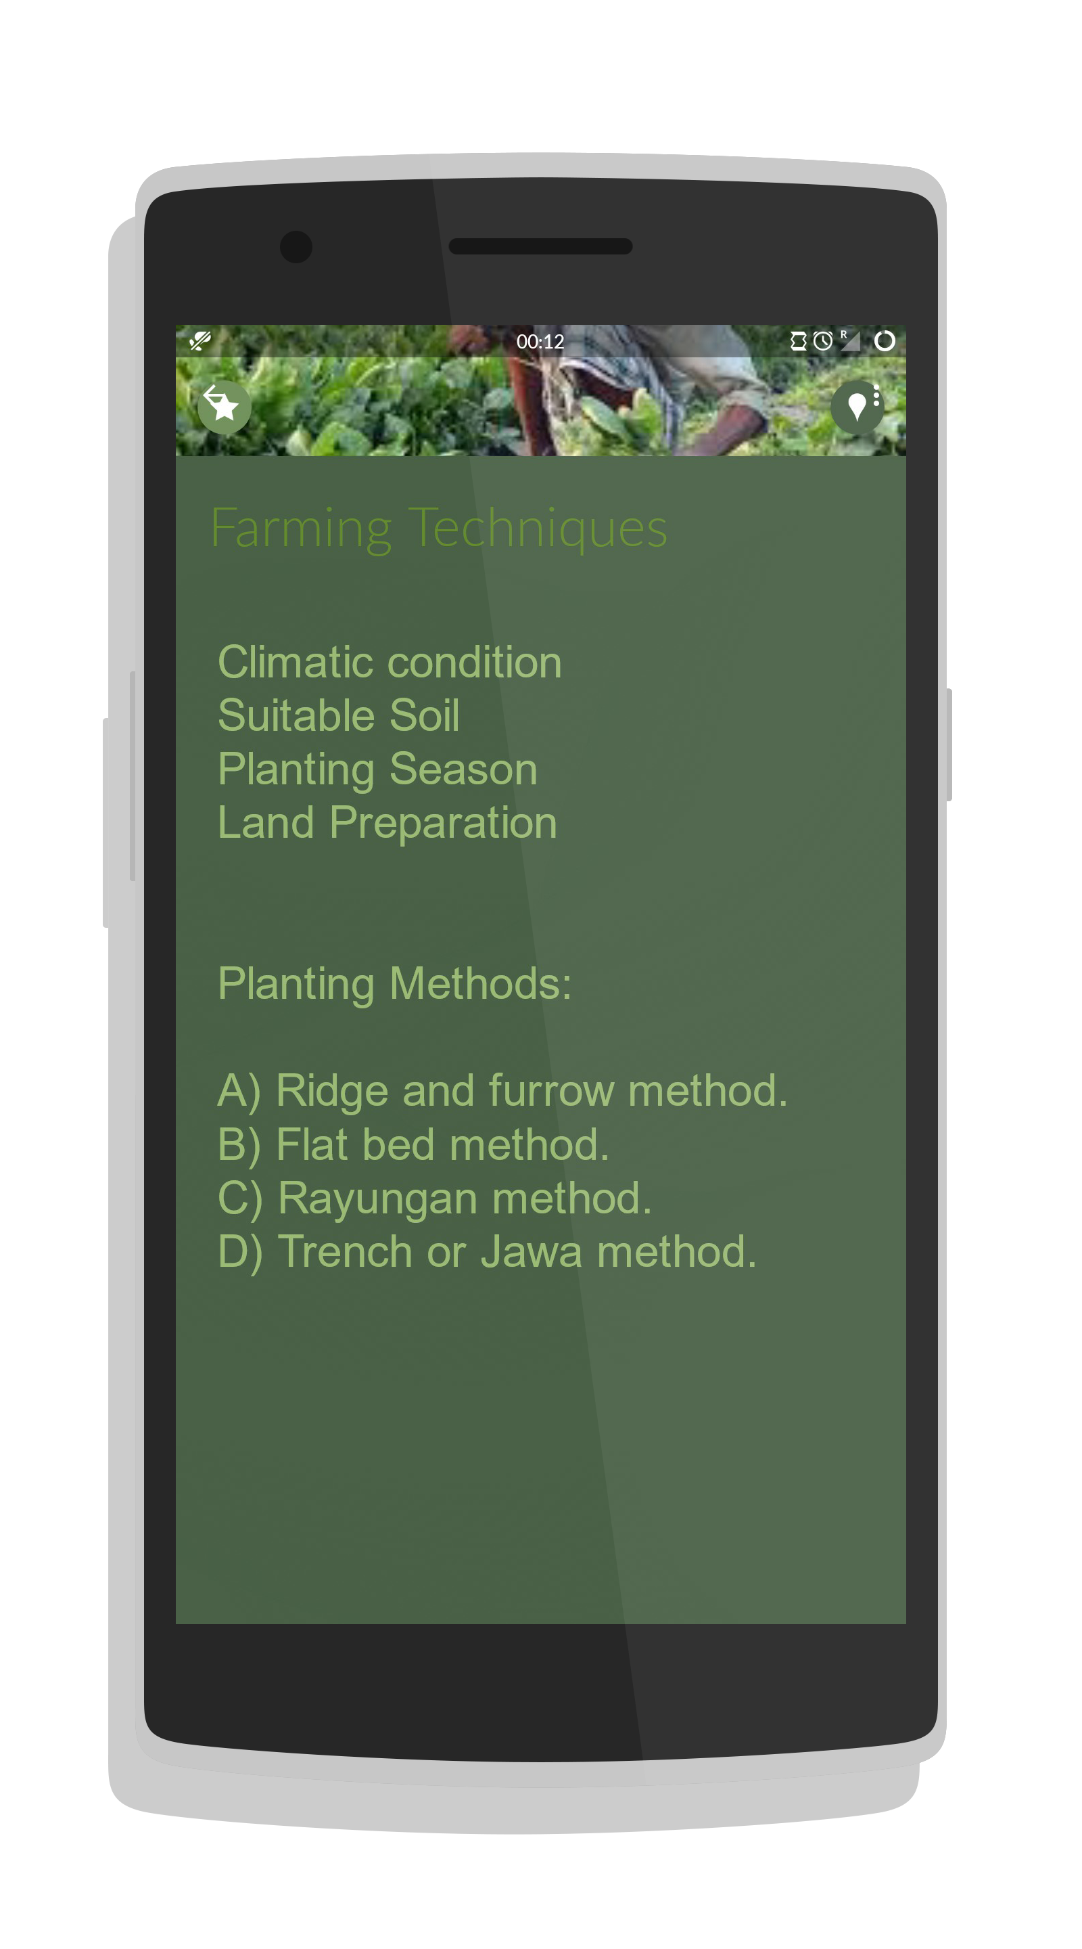
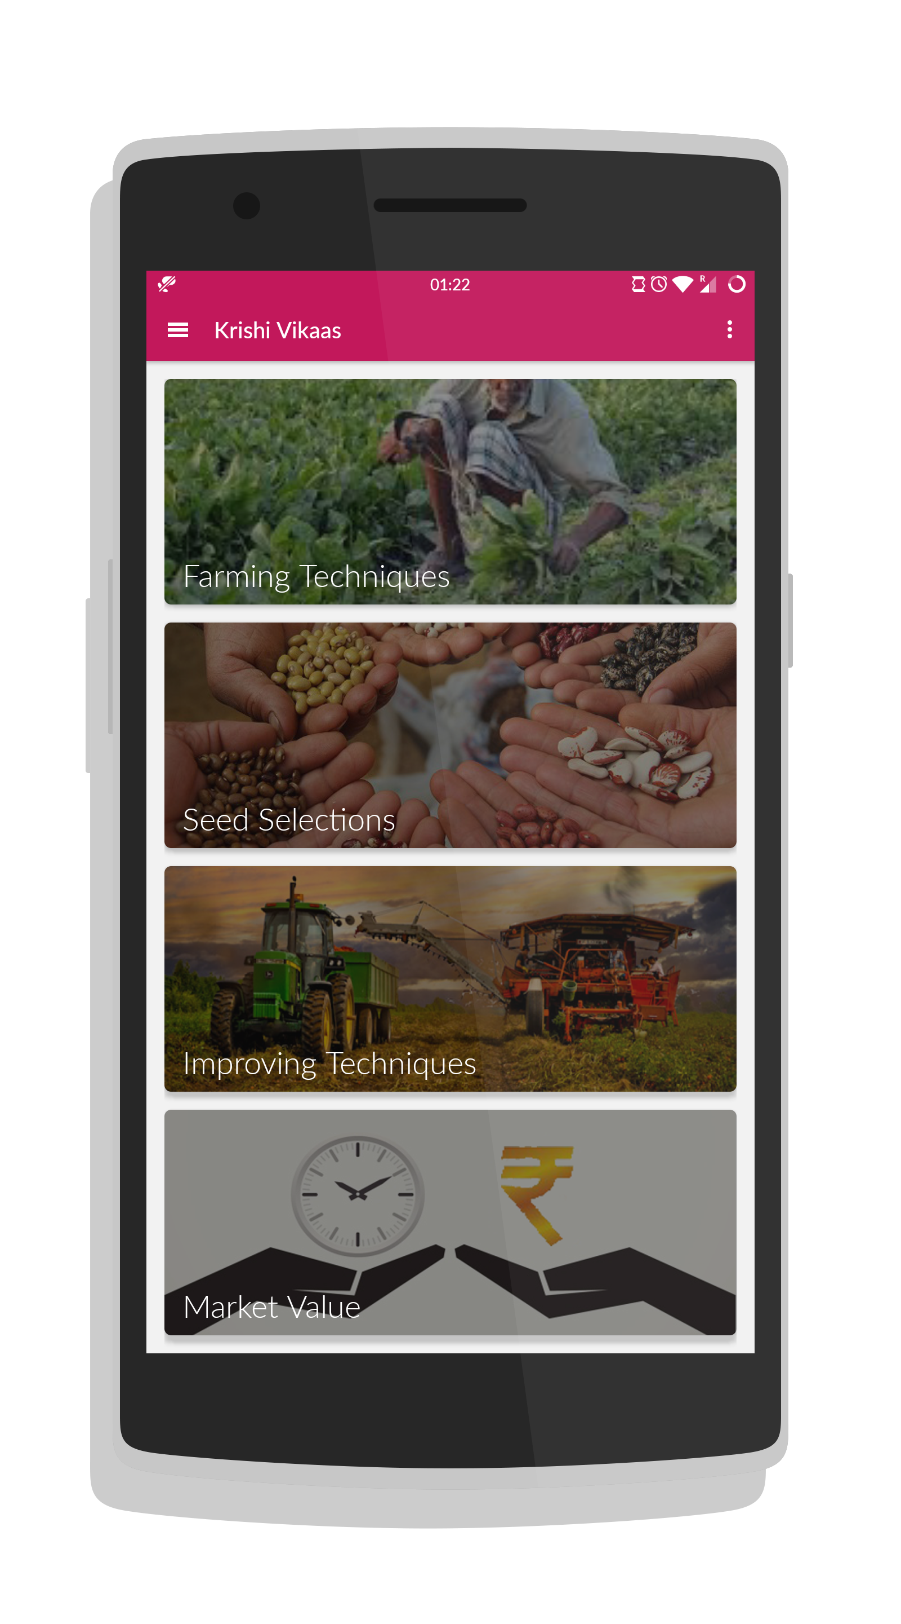
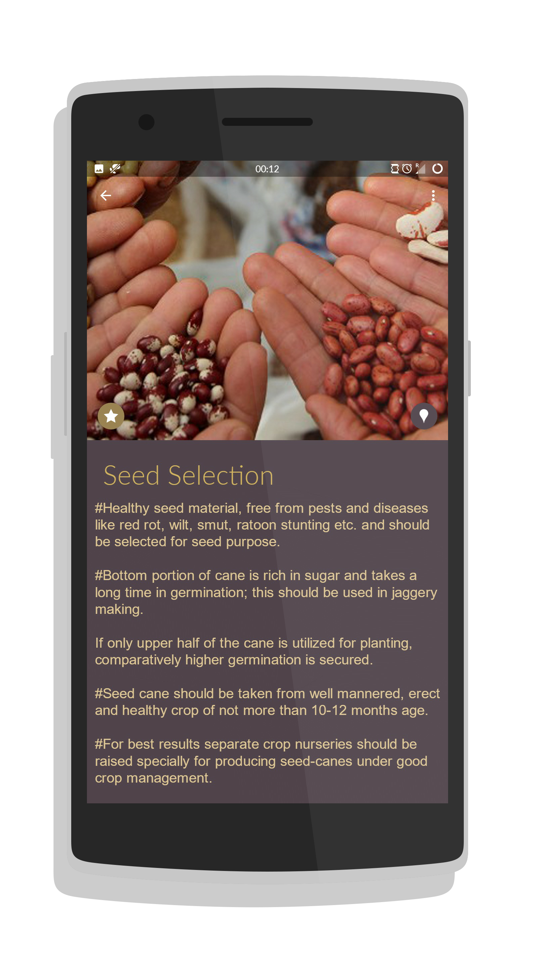
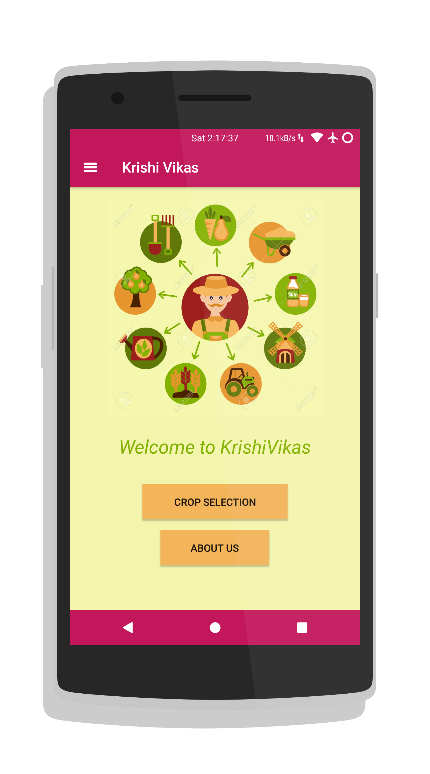
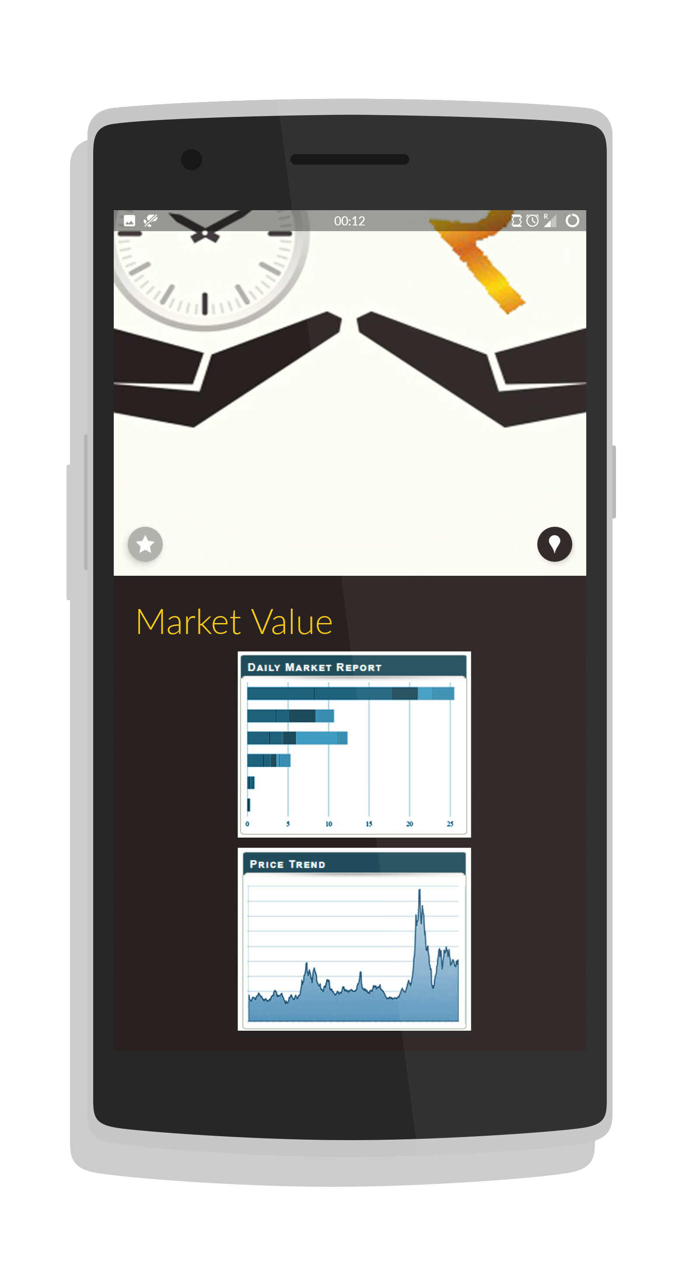
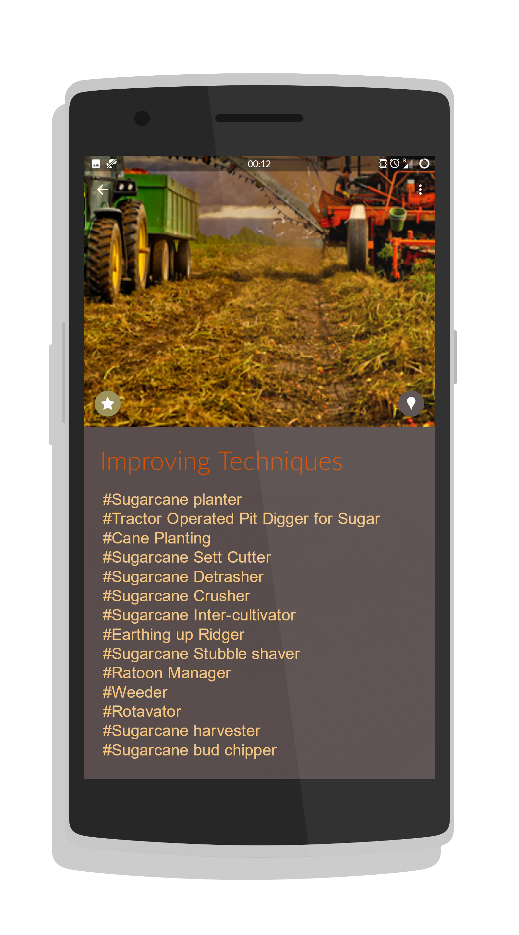
Demo/Explain how it works

Slide 7
Technology Used
Data Mining / Sentiment Analysis
Classification and Predictions
Farmer
APPLICATION
Machine learning Data mining for extraction of relevant information from various websites. Sentiment Analysis of relevant Tweets, news and reviews regarding crops.
Django Web Framework
used for the development of user interface that is easy to use and handy.

Slide 8
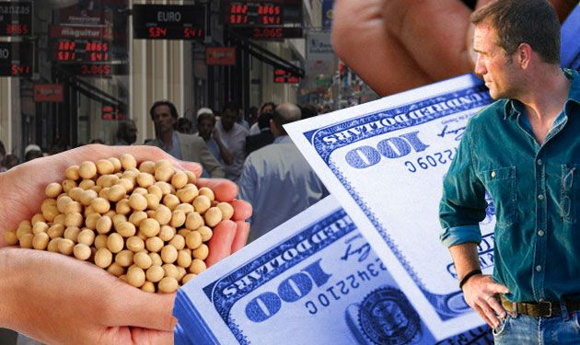
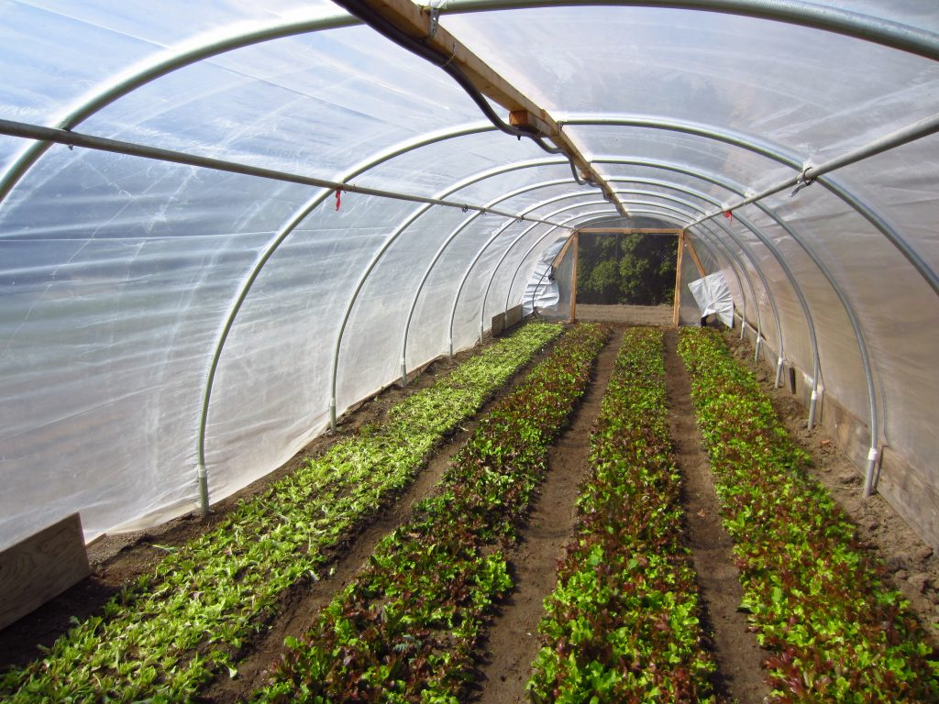
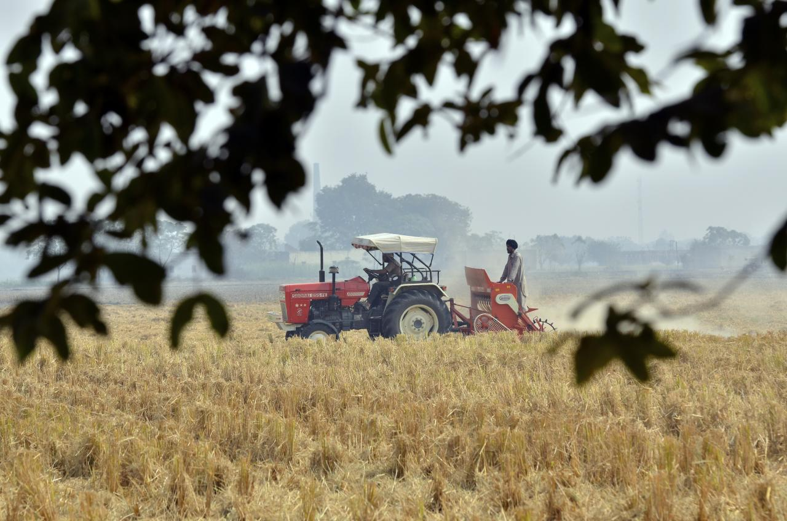
Business Model
This model will contain all the recent features on which farming depends. This will contain scattered data at one place, that will attract customers.
App can be downloaded for free. App can be motivated and advertised by government of India.
This model is sustainable since this will be working for the improvement and betterment of the crops. This will also save money of farmers and save them from getting into some sought of fraud.

Slide 9
Execution plan
This App can be reach to its customer by joining it with various government agriculture yojnas.
This app will be mostly used by Farmers. This can also be used by the retailers and the research associates. This solution can be further improvement with various new feature depending upon the market demands.
To select the major problems of in the farming and issues that are mostly faced by the farmers. This will ultimately improve the farming methods and will therefore lead to healthy crops and benefitting farmers as well in the farmer.
Our Plan is to bring the scattered data over the web to one place and use technologies to improve the existing systems.
Since this application consists of machine learning back end, so to train huge dataset needs a lot of time. This app can be fully functional within 6 months.

Slide 10
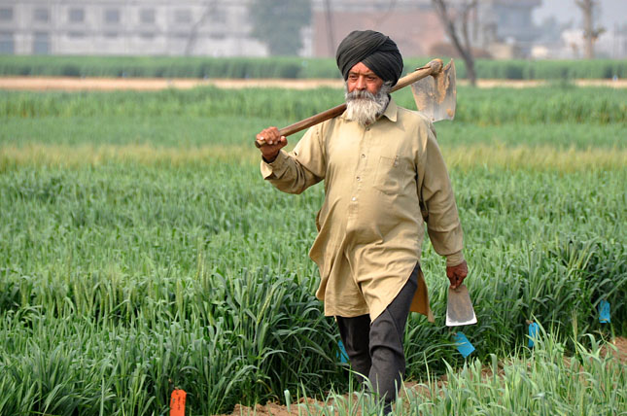
KrishiVikas
This app will help in the betterment of Agriculture. This improve the quality of the crops grown by the farmer. This will also be used to remove fraud in selling of crops by the farmers in the market. With the advancement in technology, we can use these technologies to make India (agricultural land) a better a place.
This will target the 50% of the population.
“Thank You“

